Slide 1


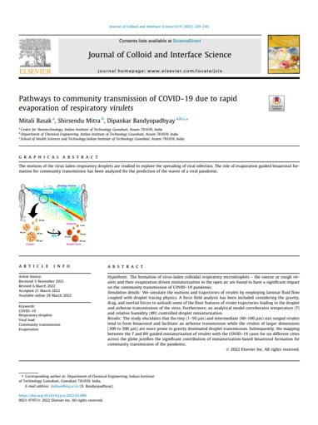
Pathways to Community Transmission of COVID-19 due to Rapid Evaporation of Respiratory Virulets
Presented By:
Ronit Malvi
210107074
Notes:
Line spacing + Page numbers

Slide 2
Objectives
Formation of virus-laden colloidal respiratory microdroplets
Virulet trajectories leading to the droplet and airborne transmissions of the virus
Role of evaporation guided bioaerosol formation
Mapping between the T and RH guided miniaturization of virulets

Slide 3


Area of Research
Fluid Mechanics
Nanotechnology
Specific Area of Research
Use of CFD simulations to study fluid flow behaviour of virulets and its impact on transmission
3

Slide 4
Methodology
01
Conducted simulations to model the evaporation-driven miniaturization of respiratory droplets under varying T and RH conditions.
Explored correlations between droplet size changes and T/RH.
Statistical models linking droplet size to infection rates.
Utilization of R programming for statistical predictive model.
Analyzed data from different geographical locations to establish regional variations.

Slide 5


Novelty
02
Targeted Novelty
Comprehensive exploration of role of virulets in transmission.
How coughing and sneezing lead to spreading of the virulets.
Subjective Novelty
Few reports considered Newton's 2nd law neglecting finer features of fluid dynamics
Addresses the effect of gravity, drag, and inertial forces in the virulets.
5

Slide 6
03
Parameters
Dependent Variables
Independent Variables
Density of air
Dynamic viscosity of Fluid
Average air inflow
Droplet density
Droplet diameter
Dynamic viscosity of droplet
Velocities of nose and mouth inlets
Viral load
Settle velocity
Settle time
Rate of evaporation
Drag Force
Inertial Force
Temperature
Viral Concentration
Radius of virulet of time of fall
Relative Humidity

Slide 7
Results and Discussion
04.1
Viral load of Sneeze/Cough droplets
Virulet's viral load depends on the patient's viral concentration, and their infectiousness follows a Poisson distribution.
Larger virulets can carry more virus particles and pose a greater transmission risk.
Motion of respiratory virulets
Smaller virulets (1–50 µm) travel far, larger ones (300–500 µm) settle quickly, affecting transmission modes.
Various virulet sizes challenge 2-meter distancing, increasing risk via airborne and droplet/fomite routes.

Slide 8
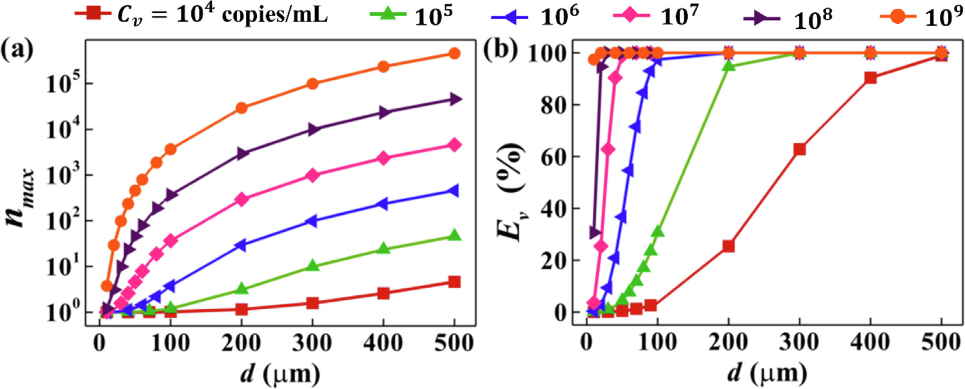
Plot (a) shows the maximum number of viruses nmax loaded inside a droplet of size d ejected from an infected person, and plot (b) shows the fraction of Ev among the total droplets ejected of size d, for Cv ranging from 104 copies/mL to 109 copies/mL and d ranging from 1 to 500 lm.

Slide 9
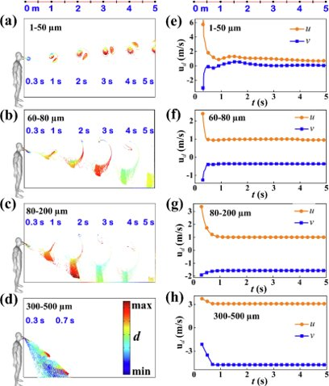
Plots (a) – (d) show the flight trajectory and (e) – (h) shows the corresponding velocity profiles of the virulets expelled from the sneeze of a SARS-CoV-2 infected
Person.
The color bar in subplot (d) shows the dimension range of the simulated virulets, the terms ‘min’ and ‘max’ indicate minimum virulet diameter and the maximum virulet diameter of that droplet range, as considered in subplots (a–d).

Slide 10
Results and Discussion
04.2
Analyses of force fields acting on virulets
Trajectories of virulets depend on inertia, drag, and gravity forces, vital for assessing infectivity during sneezing.
Smaller virulets (1–50 µm) travel farther due to inertia and drag.
Larger virulets (300–500 µm) settle quickly due to dominant gravity and drag, supported by calculations of Froude's, Reynolds, Weber, and Capillary numbers.
Effects of multiple ejections and wind flow
Simultaneous sneezing and coughing increase virulet density, elevating transmission risk in the vicinity.
Frequent sneezing events raise virulet density, posing risks to nearby individuals.
Wind conditions impact virulet spread, with higher speeds extending transmission distance, potentially contributing to community transmission via natural airflow patterns.

Slide 11
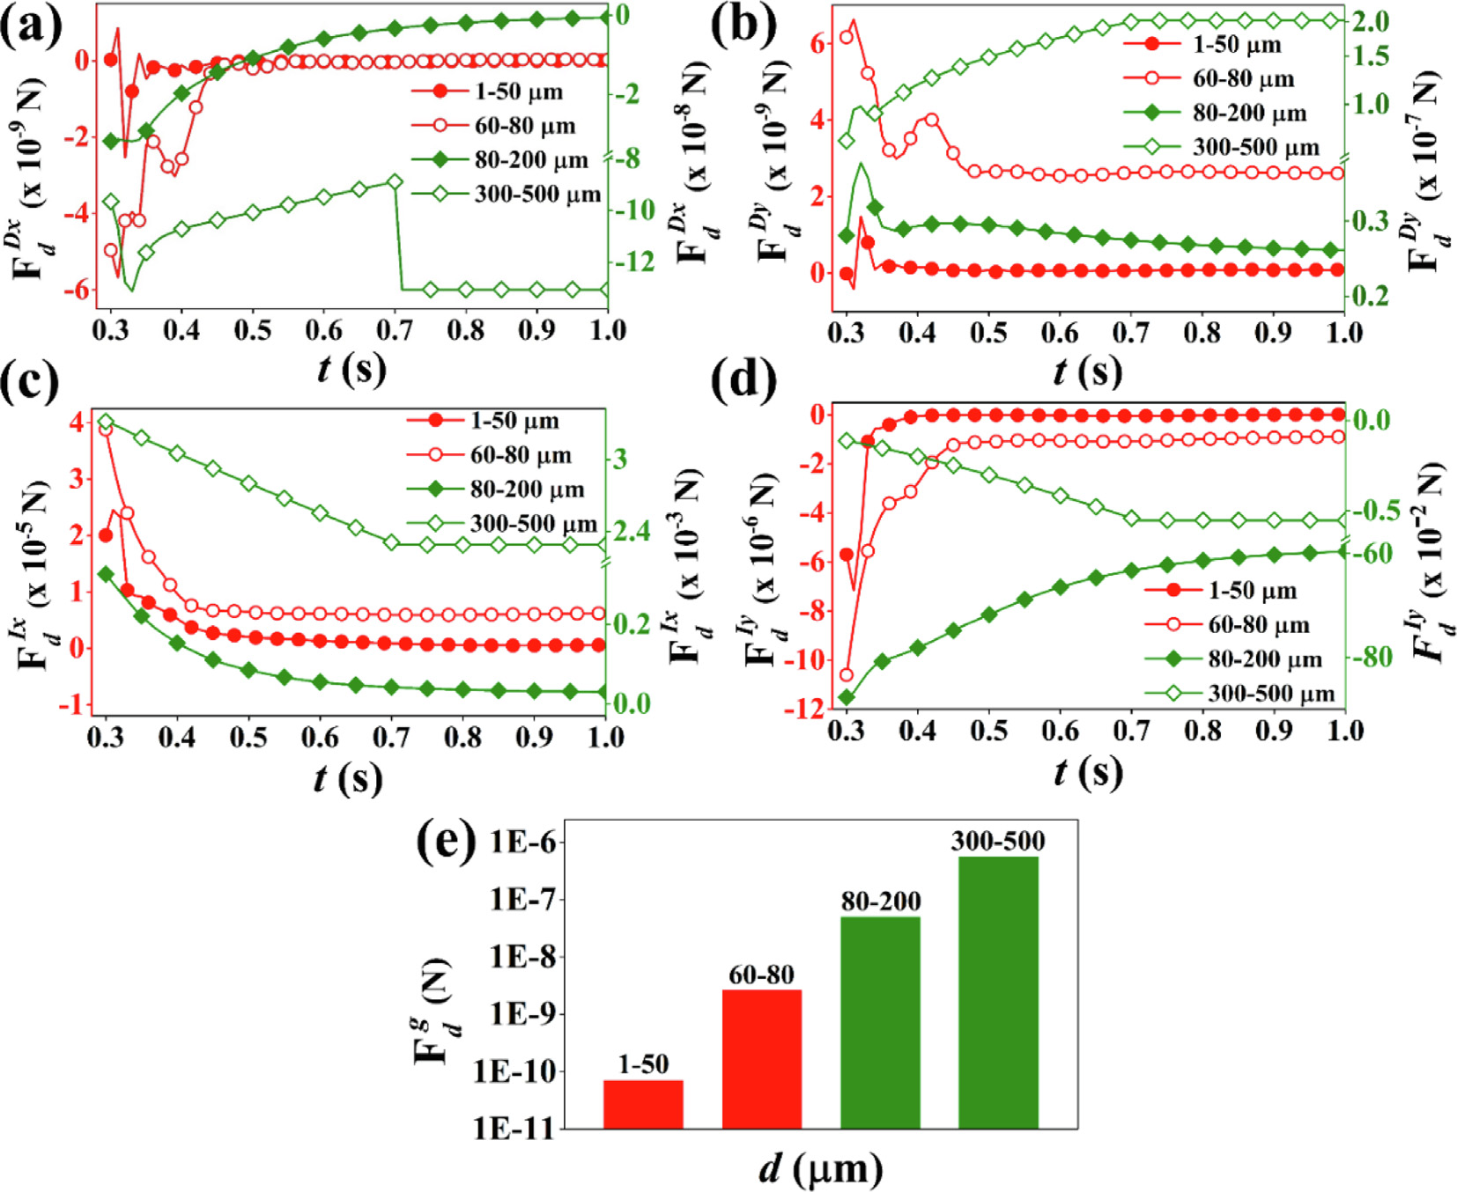
Plots (a) to (e) show the x – directional drag force (FDx
d ), y – directional drag force (FDyd ), x – directional inertia force (FIxd ), and negative y – directional inertia force (FIy
d ),and negative gravitational force (Fgd) ejected via sneezing.

Slide 12
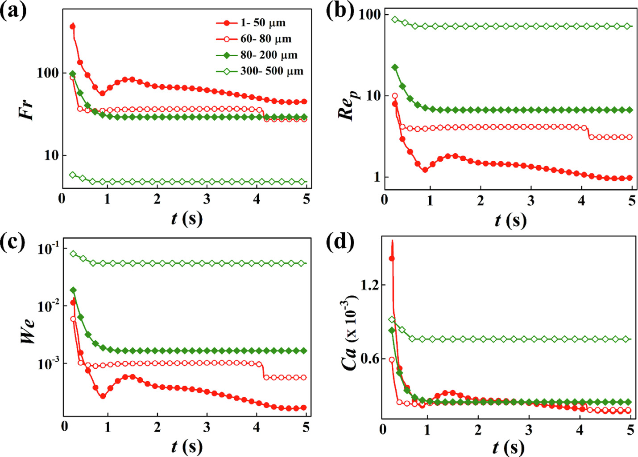
Plots (a–d) show the Froude number, Reynolds number, Weber number, and Capillary number for the virulets ejected via sneezing, respectively.

Slide 13
Results and Discussion
04.3
Effect of temperature and relative humidity on virulet evaporation
SARS-CoV-2 transmission depends on the distance virulets can travel.
Virulet settling time, affected by evaporation rate influenced by temperature and humidity, impacts infection potency and bioaerosol formation, thereby affecting virus transmission in varying climate conditions.
Comparison of COVID-19 infection and virulet evaporation
Smaller virulets (1–50 µm) travel far, larger ones (300–500 µm) settle quickly, affecting transmission modes.
Various virulet sizes challenge 2-meter distancing, increasing risk via airborne and droplet/fomite routes.

Slide 14
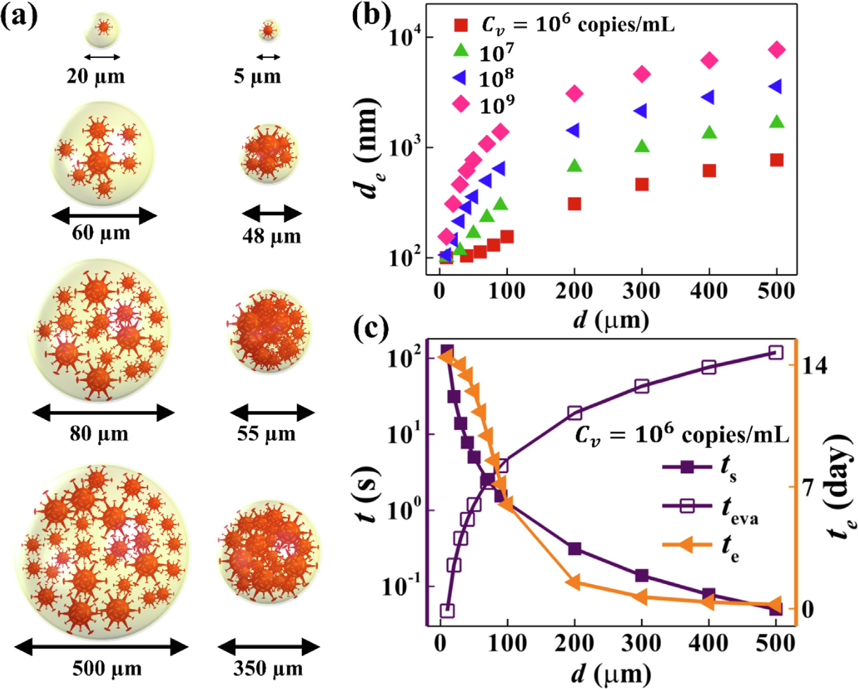
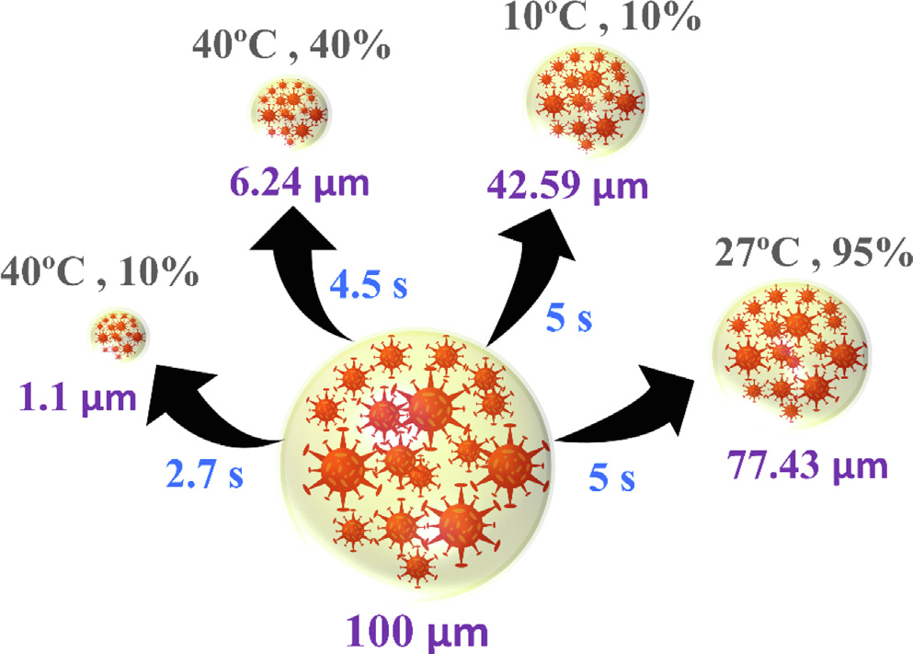
Plot (a) schematically shows the miniaturization of the virulets at T = 25 C and RH = 50%. Plot (b) shows the minimum possible de that an ejected droplet d can achieve after complete evaporation for different Cv ranging from 106 to 109 copies/mL. Plot (c) shows the comparison of ts ,
teva, and te for Cv ¼ 106 copies/mL.
Schematically shows the effect of evaporation due to variation in T (in C) and RH (in %) conditions on a 100 lm sized virulet.

Slide 15
Conclusion
The study investigates fluid dynamics related to the community transmission of highly contagious SARS-CoV-2.
It examines the behavior of respiratory droplets (virulets) during activities like sneezing and coughing.
The research considers the role of bioaerosol transmission and how it can spread the disease over longer distances.
Geographical factors such as temperature and humidity (T and RH) are analyzed for their influence on virulet transmission.
The study suggests a potential relationship between T, RH, and infection waves, laying the groundwork for future research in bioaerosol dynamics and community transmission.

Slide 16
Literature References
Torales J., O’Higgins M., Castaldelli-Maia J.M., Ventriglio A. The outbreak of COVID-19 coronavirus and its impact on global mental health. Int. J. Soc. Psychiatry. 2020;66(4):317–320. - PubMed
Kim S., Kim P.B., Lee G. Predicting hospitality employees’ safety performance behaviors in the COVID-19 pandemic. Int. J. Hospital. Manage. 2021;93:102797. doi: 10.1016/j.ijhm.2020.102797. - DOI
Liu Y., Qu H.-Q., Qu J., Tian L., Hakonarson H. Expression pattern of the SARS-CoV-2 entry genes ACE2 and TMPRSS2 in the respiratory tract. Viruses. 2020;12(10):1174. - PMC - PubMed
Bourouiba L. Turbulent gas clouds and respiratory pathogen emissions: potential implications for reducing transmission of COVID-19. JAMA. 2020;323(18):1837–1838. - PubMed
Organization W.H. World Health Organization; 2020. Modes of transmission of virus causing COVID-19: implications for IPC precaution recommendations: scientific brief, 27 March 2020.
Klompas M., Baker M.A., Rhee C. Airborne transmission of SARS-CoV-2: theoretical considerations and available evidence. JAMA. 2020;324(5):441. doi: 10.1001/jama.2020.12458. - DOI - PubMed
Diwan S.S., Ravichandran S., Govindarajan R., Narasimha R. Understanding transmission dynamics of COVID-19-type infections by direct numerical simulations of cough/sneeze flows. Trans. Ind. Natl. Acad. Eng. 2020;5(2):255–261.
Dbouk T., Drikakis D. On coughing and airborne droplet transmission to humans. Phys. Fluids. 2020;32(5):053310. doi: 10.1063/5.0011960. - DOI - PMC - PubMed

Slide 17

Thank You

